Slide 1
Output Primitives
Dr. Subhadip Basu
Professor, CSE Dept., JU
Subhadip.Basu@jadavpuruniversity.in

Slide 2
Contents (Part-I)
Graphics hardware
The problem of scan conversion
Considerations
Line equations
Scan converting algorithms
  A very simple solution
  The DDA algorithm
Conclusion

Slide 3
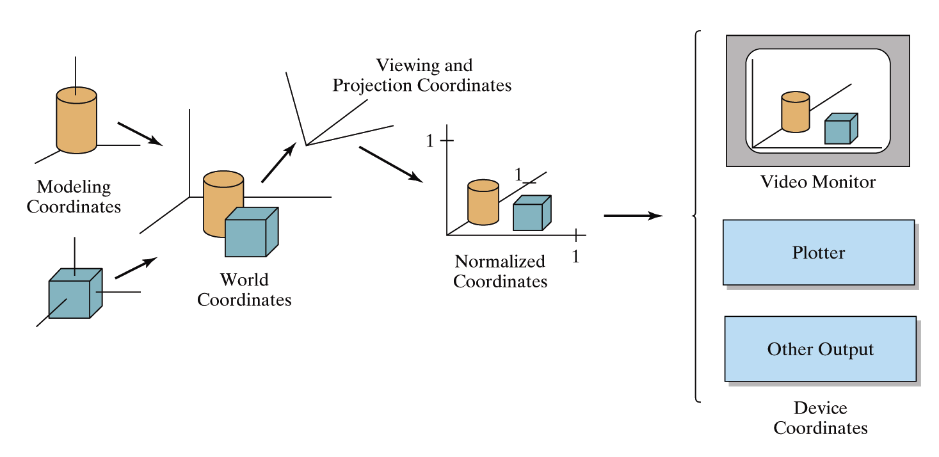

Graphics Hardware
It’s worth taking a little look at how graphics hardware works before we go any further
How do things end up on the screen?
Images taken from Hearn & Baker, “Computer Graphics with OpenGL” (2004)

Slide 4
Architecture Of A Graphics System
Display Processor Memory
Frame Buffer
Video Controller
Monitor
Monitor
CPU
Display Processor
System Memory
System Bus

Slide 5
Output Devices
There are a range of output devices currently available:
  Printers/plotters
  Cathode ray tube displays
  Plasma displays
  LCD displays
  3 dimensional viewers
  Virtual/augmented reality headsets
We will look briefly at some of the more common display devices

Slide 6
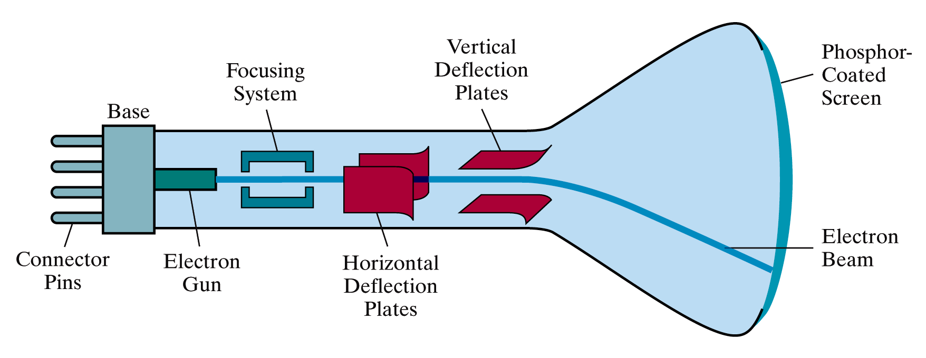
Basic Cathode Ray Tube (CRT)
Fire an electron beam at a phosphor coated screen
Images taken from Hearn & Baker, “Computer Graphics with OpenGL” (2004)

Slide 7
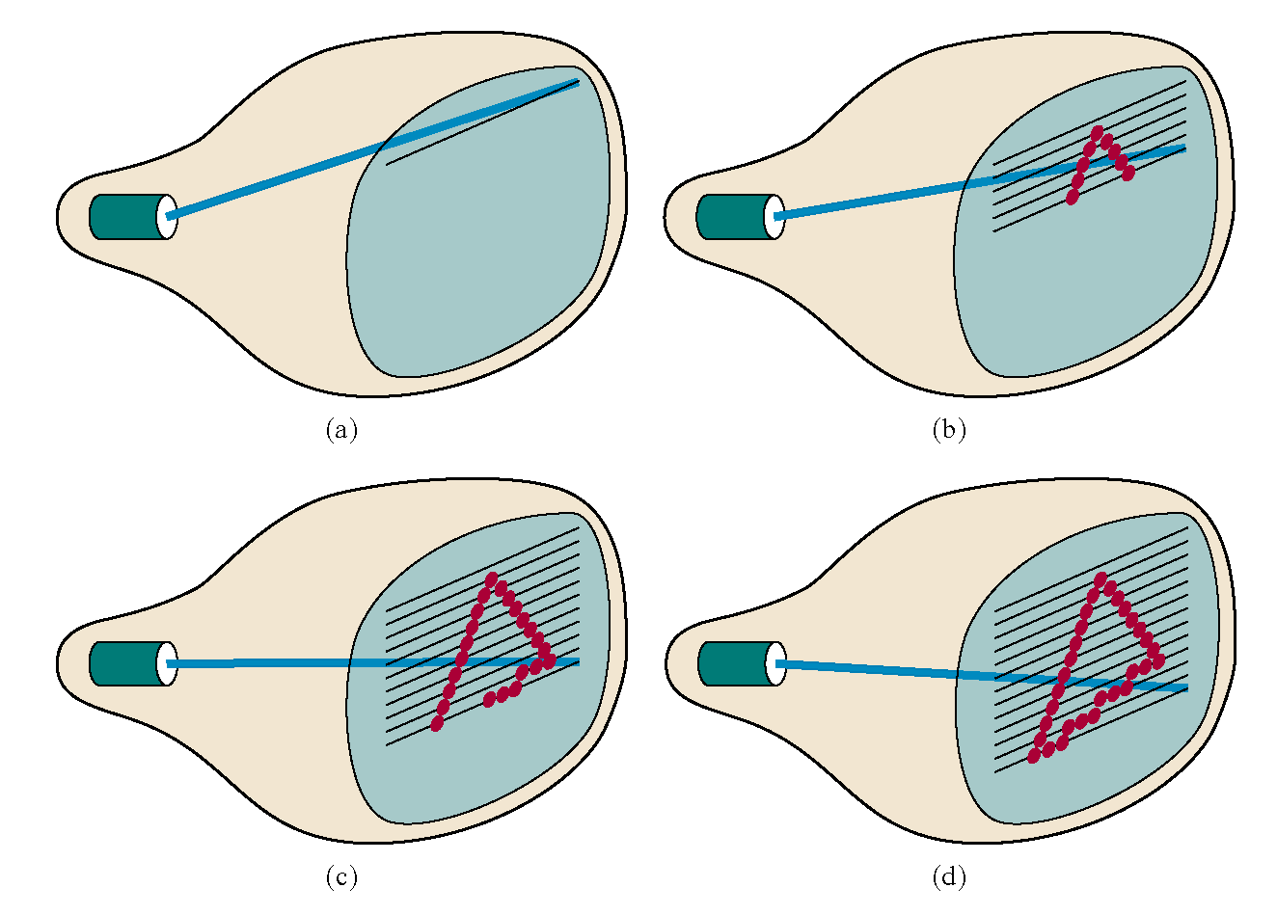
Raster Scan Systems
Draw one line at a time
Images taken from Hearn & Baker, “Computer Graphics with OpenGL” (2004)

Slide 8
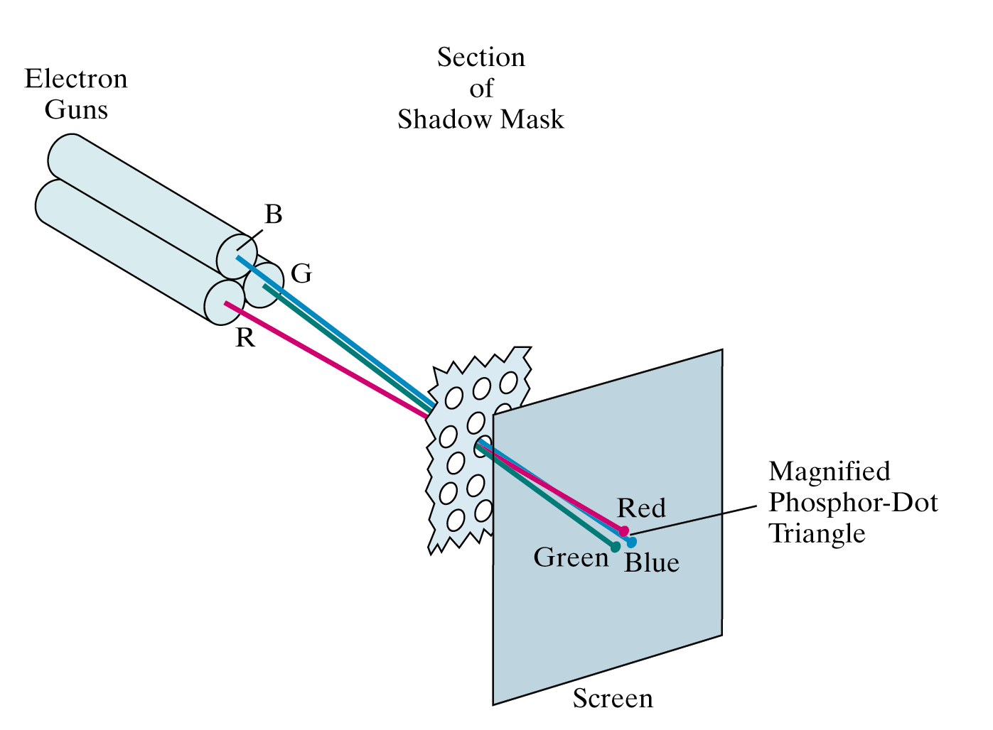
Colour CRT
An electron gun for each colour – red, green and blue
Images taken from Hearn & Baker, “Computer Graphics with OpenGL” (2004)

Slide 9
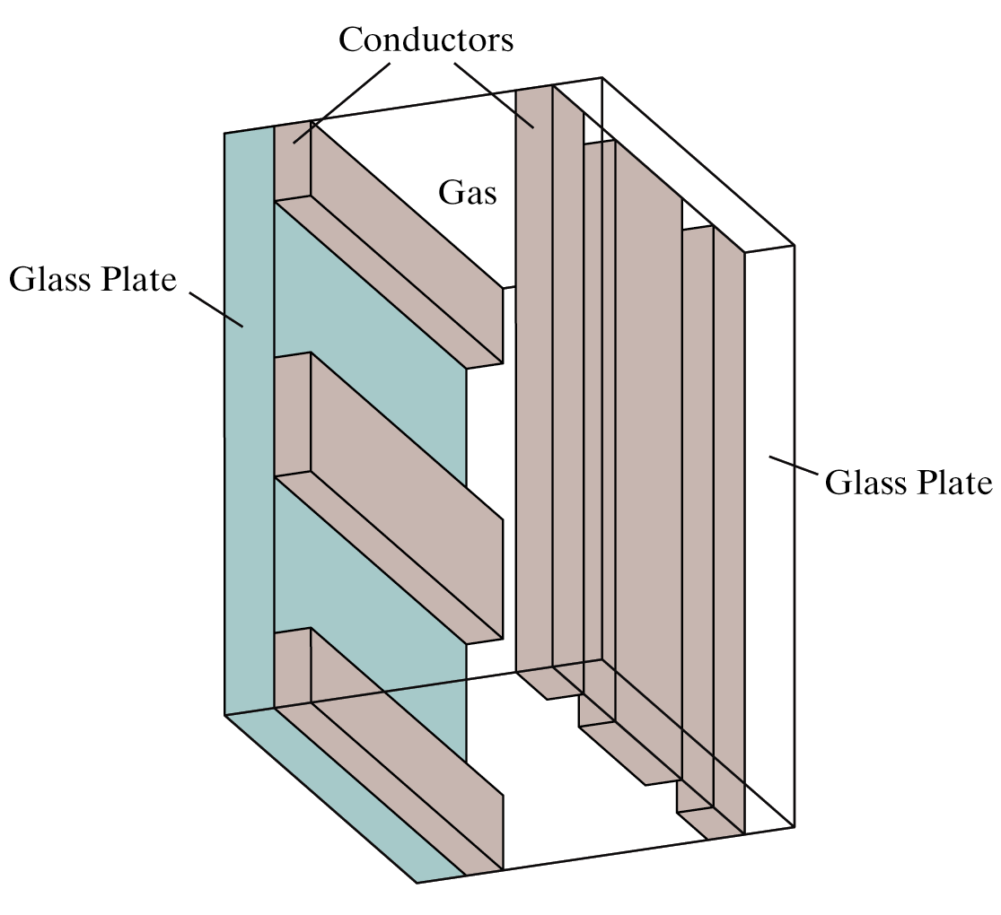
Plasma-Panel Displays
Applying voltages to crossing pairs of conductors causes the gas (usually a mixture including neon) to break down into a glowing plasma of electrons and ions
Images taken from Hearn & Baker, “Computer Graphics with OpenGL” (2004)

Slide 10
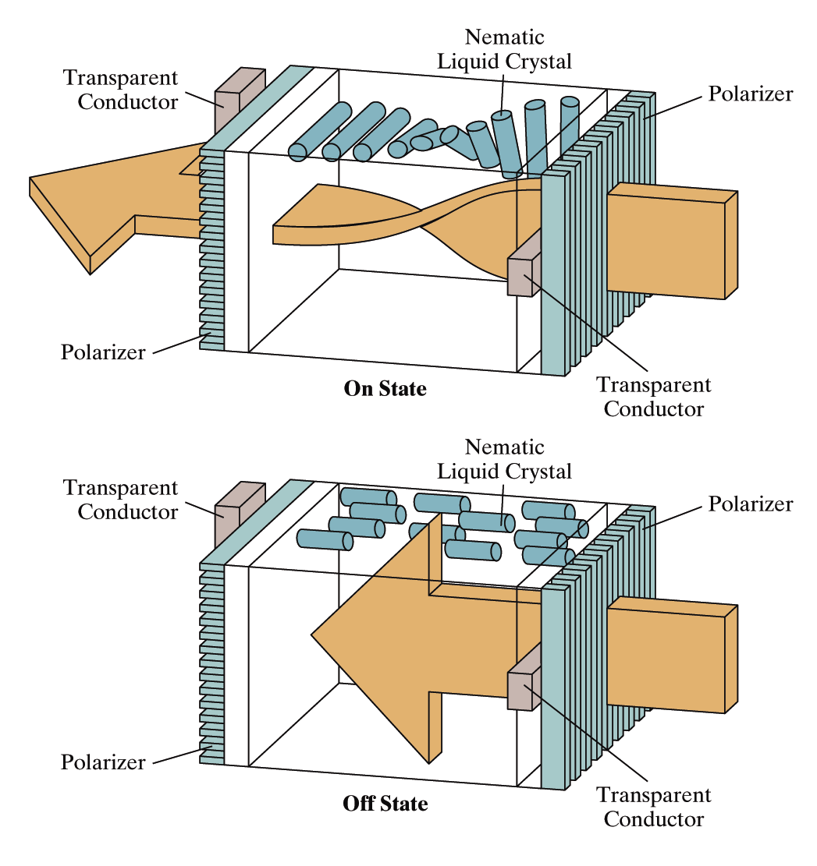
Liquid Crystal Displays
Light passing through the liquid crystal is twisted so it gets through the polarizer
A voltage is applied using the crisscrossing conductors to stop the twisting and turn pixels off
Images taken from Hearn & Baker, “Computer Graphics with OpenGL” (2004)

Slide 11
The Problem Of Scan Conversion
A line segment in a scene is defined by the coordinate positions of the line end-points
y
(7, 5)
(2, 2)
x

Slide 12
The Problem (cont…)
But what happens when we try to draw this on a pixel based display?
How do we choose which pixels to turn on?

Slide 13
Considerations
Considerations to keep in mind:
  The line has to look good
    Avoid jaggies
  It has to be lightening fast!
    How many lines need to be drawn in a typical scene?
    This is going to come back to bite us again and again

Slide 14
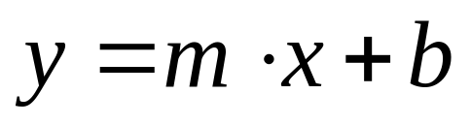
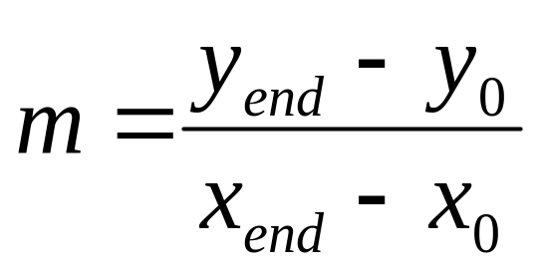
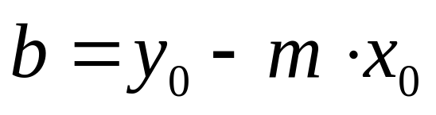
Line Equations
Let’s quickly review the equations involved in drawing lines
Slope-intercept line equation:
y
y_{end}
where:
y₀
x₀
x_{end}
x

Slide 15
Lines & Slopes
The slope of a line (m) is defined by its start and end coordinates
The diagram below shows some examples of lines and their slopes
m = ∞
m = -4
m = 4
m = -2
m = 2
m = -1
m = 1
m = -¹/₂
m = ¹/₂
m = -¹/₃
m = ¹/₃
m = 0
m = 0

Slide 16
A Very Simple Solution
We could simply work out the corresponding y coordinate for each unit x coordinate
Let’s consider the following example:
y
(7, 5)
5
2
(2, 2)
2
7
x

Slide 17
A Very Simple Solution (cont…)
5
4
3
2
1
0
0
1
2
3
4
5
6
7

Slide 18
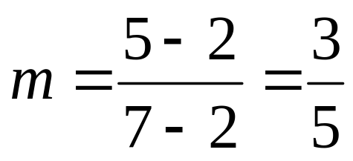
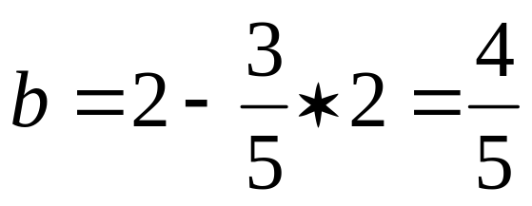
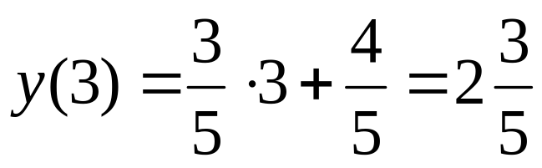
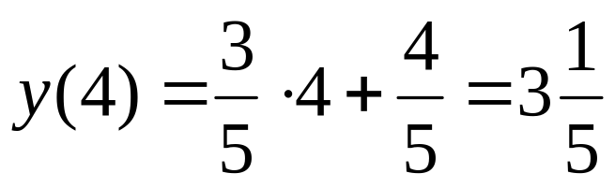
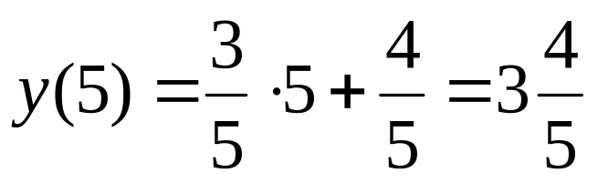
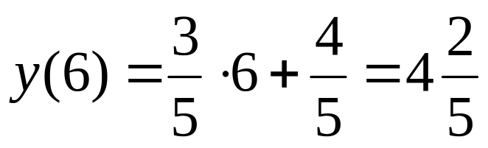
A Very Simple Solution (cont…)
y
(7, 5)
First work out m and b:
5
2
(2, 2)
2
3
4
5
6
7
x
Now for each x value work out the y value:

Slide 19
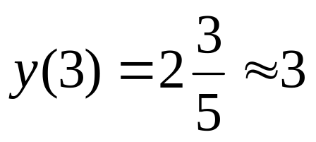
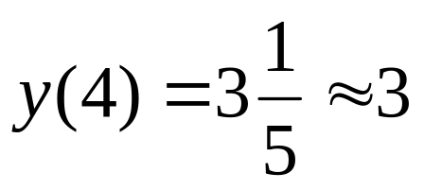
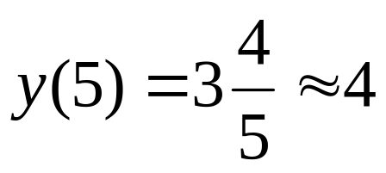
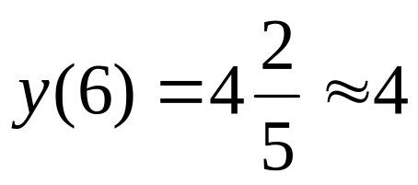
A Very Simple Solution (cont…)
Now just round off the results and turn on these pixels to draw our line
7
6
5
4
3
2
1
0
0
1
2
3
4
5
6
7
8

Slide 20
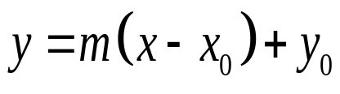
Simple Algorithm
Start x at origin of line
Evaluate y value
Set nearest pixel (x,y)
Move x one pixel toward other endpoint
Repeat until done

Slide 21
Implementation
// SimplePixelCalc - elementary pixel calculation using
// variation of y=mx+b
void SimplePixelCalc( int x0, int xn, int y0, int yn )
{
for( int ix=x0; ix<=xn; ix++ )
{
float fy = y0 + float(yn-y0)/float(xn-x0)*ix; // round to nearest whole integer
int iy = (int)(fy+0.5);
SetPixel(ix, iy, 1); // write pixel value
}
}
How well does this work?
Estimate the time taken to execute the task

Slide 22
A Very Simple Solution (cont…)
However, this approach is just way too slow
In particular look out for:
  The equation y = mx + b requires the multiplication of m by x
  Rounding off the resulting y coordinates
We need a faster solution

Slide 23
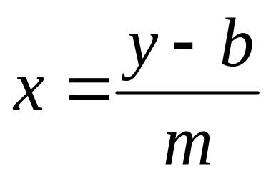
A Quick Note About Slopes
In the previous example we chose to solve the parametric line equation to give us the y coordinate for each unit x coordinate
What if we had done it the other way around?
So this gives us:
where: and

Slide 24
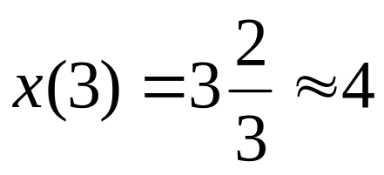
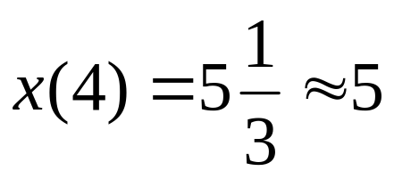
A Quick Note About Slopes (cont…)
Leaving out the details this gives us:
We can see easily that
this line doesn’t look
very good!
We choose which way
to work out the line
pixels based on the
slope of the line
7
6
5
4
3
2
1
0
0
1
2
3
4
5
6
7
8

Slide 25
A Quick Note About Slopes (cont…)
If the slope of a line is between -1 and 1 then we work out the y coordinates for a line based on it’s unit x coordinates
Otherwise we do the opposite – x coordinates are computed based on unit y coordinates
m = ∞
m = -4
m = 4
m = -2
m = 2
m = -1
m = 1
m = -¹/₂
m = ¹/₂
m = -¹/₃
m = ¹/₃
m = 0
m = 0

Slide 26
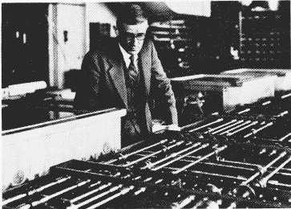
The DDA Algorithm
The digital differential analyzer (DDA) algorithm takes an incremental approach in order to speed up scan conversion
Simply calculate y_{k+1} based on y_{k}
The original differential analyzer was a physical machine developed by Vannevar Bush at MIT in the 1930’s in order to solve ordinary differential equations.
More information here.

Slide 27
Digital Differential Analyzer
(DDA) Algorithm
Step through either x or y based on slope
Build the line parametrically
  If |m|<1
    x_{k+1} = x_{k} + 1
    y_{k+1} = y_{k} + m
  If |m|>1
    x_{k+1} = x_{k} + 1/m
    y_{k+1} = y_{k} + 1
  If |m|=1
    x_{k+1} = x_{k} + 1
    y_{k+1} = y_{k} + 1

Slide 28
The DDA Algorithm (cont…)
Consider the list of points that we determined for the line in our previous example:
(2, 2), (3, 2³/₅), (4, 3¹/₅), (5, 3⁴/₅), (6, 4²/₅), (7, 5)
Notice that as the x coordinates go up by one, the y coordinates simply go up by the slope of the line
This is the key insight in the DDA algorithm

Slide 29
The DDA Algorithm (cont…)
Again the values calculated by the equations used by the DDA algorithm must be rounded to match pixel values
(x_{k}+1, round(y_{k}+m))
(round(x_{k}+ ¹/_{m}), y_{k}+1)
(x_{k}, y_{k})
(x_{k}+ ¹/_{m}, y_{k}+1)
(x_{k}+1, y_{k}+m)
(x_{k}, y_{k})
(x_{k}, round(y_{k}))
(round(x_{k}), y_{k})

Slide 30
DDA Algorithm Example
Let’s try out the following examples:
y
y
(2, 7)
7
(7, 5)
5
2
2
(2, 2)
(3, 2)
2
7
x
2
3
x

Slide 31
DDA Implementation
void dda( int x0, int xn, int y0, int yn )
{
float dx = float(xn - x0); // total span in x
float dy = float(yn - y0); // total span in y
float y = float(y0);
float x = float(x0);
float Dx, Dy; // incremental steps in x & y
// determine if slope m GT or LT 1
if( dx > dy )
{
Dx = 1;
Dy = dy/dx;// floating division, but only done once per line
}
else
{
Dx = dx/dy;
Dy = 1;
}
int ix, iy; // pixel coords
for( int k=0; k<=((dx>dy)? dx:dy); k++ )
{
ix = int(x + 0.5); // round to nearest pixel coordinate
iy = int(y + 0.5);
x += Dx; // floating point calculations
y += Dy;
}
}
Estimate the time taken to execute the task

Slide 32
The DDA Algorithm Summary
The DDA algorithm is much faster than our previous attempt
  In particular, there are no longer any multiplications involved
However, there are still two big issues:
  Accumulation of round-off errors can make the pixelated line drift away from what was intended
  The rounding operations and floating point arithmetic involved are time consuming

Slide 33
Conclusion
    In this lecture we took a very brief look at how graphics hardware works
    Drawing lines to pixel based displays is time consuming so we need good ways to do it
    The DDA algorithm is pretty good – but we can do better
    Next time we’ll like at the Bresenham line algorithm and how to draw circles, fill polygons and anti-aliasing

Slide 34
Line Drawing Algorithms
Part - 2
Dr. Subhadip Basu
Professor, CSE Dept., JU
subhadip@cse.jdvu.ac.in

Slide 35
Contents (Part-II)
In today’s lecture we’ll have a look at:
  Bresenham’s line drawing algorithm
  Line drawing algorithm comparisons
  Circle drawing algorithms
    A simple technique
    The mid-point circle algorithm
  Polygon fill algorithms
  Summary of raster drawing algorithms

Slide 36
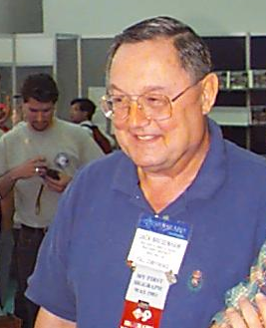
The Bresenham Line Algorithm
The Bresenham algorithm is another incremental scan conversion algorithm
The big advantage of this algorithm is that it uses only integer calculations
Jack Bresenham worked for 27 years at IBM before entering academia. Bresenham developed his famous algorithms at IBM in the early 1960s

Slide 37
Analyzing errors at each point
8
7
6
5
4
3
2
1
0
0
1
2
3
4
5
6
7
8
9
10
11

Slide 38
Error Analysis – for m<1
d₂
For |m|<1, there is only 1 pixel lit in each column
1+y_{k}
y_{k}
y_{k}
x_{k}
x_{k+1}
d₁
Note: when |m|<1,
x_{k+1} = 1+x_{k}

Slide 39
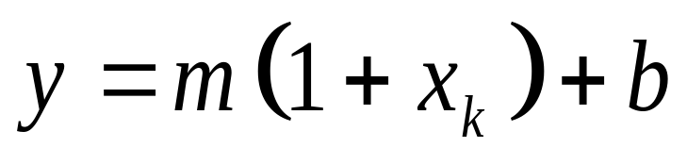
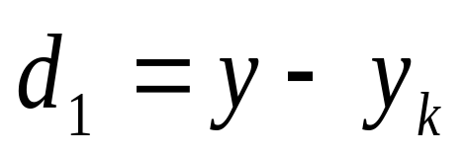
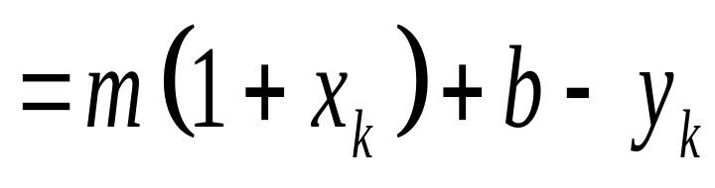
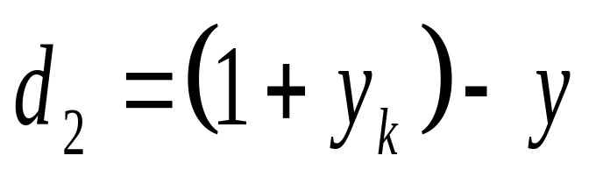
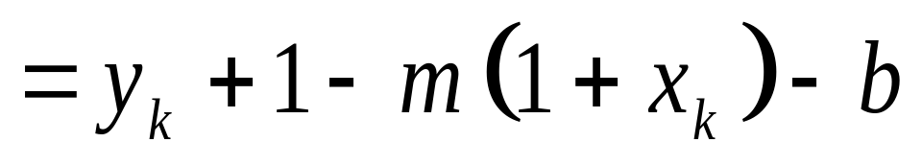
Computation of error values
1+y_{k}
d₂
y
d₁
Now substitute for y
y_{k}
x_{k+1}
Note: when |m|<1,
x_{k+1} = 1+x_{k}

Slide 40
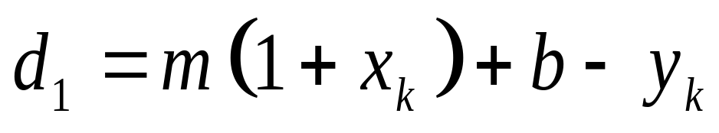
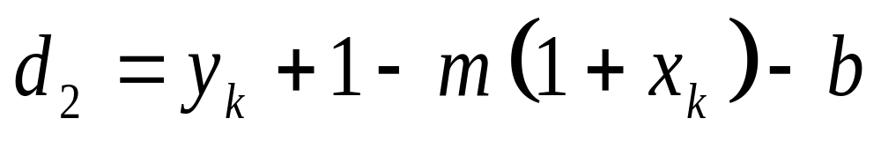
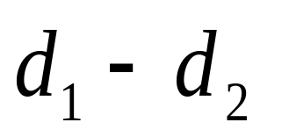
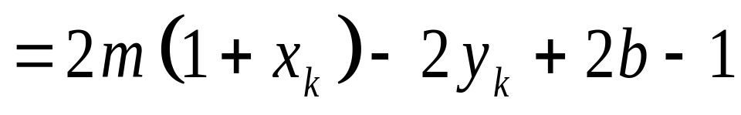
Deciding on the Next Point
1+y_{k}
d₂
y
d₁
y_{k}
x_{k+1}
Decision value

Slide 41
Decision point
1+y_{k}
If d₂>d₁ (ie d₁-d₂<0),
y_{k+1} = y_{k}
d₂
y
d₁
If d₂<d₁ (ie d₁-d₂>0),
y_{k+1} = 1 + y_{k}
y_{k}
x_{k+1}
Decision value

Slide 42
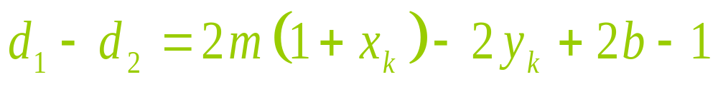
Status Check
What have we accomplished?
  One value to test (+/–)
But …
  Still have floating-point calculation
    “m” and “b” are non-integer

Slide 43
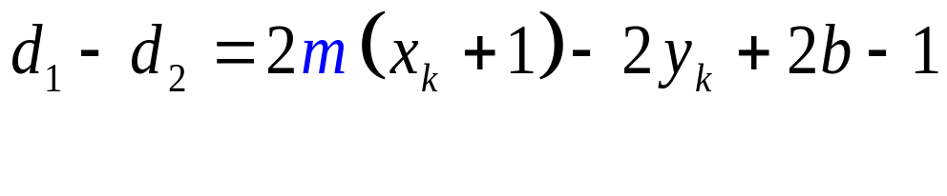
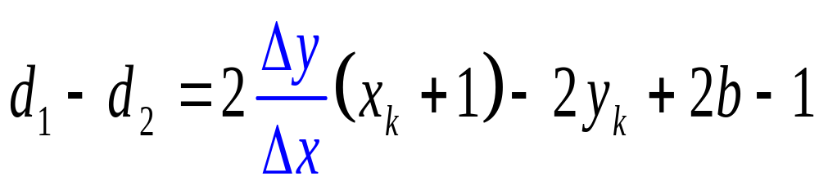
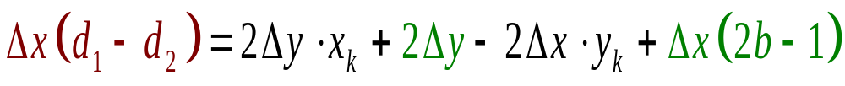
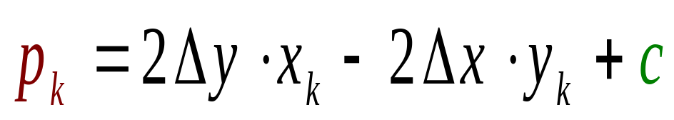
Removing Non-Integral Values
What is m?
Now multiply throughout by Δx
Which terms are constants?
Decision value
c is constant, but non-integer

Slide 44
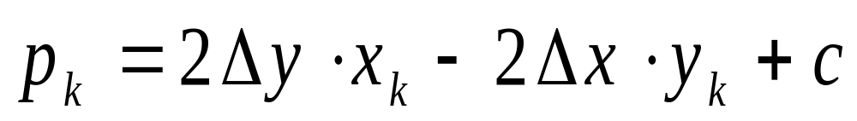
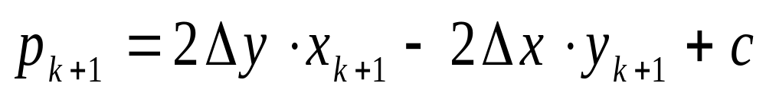
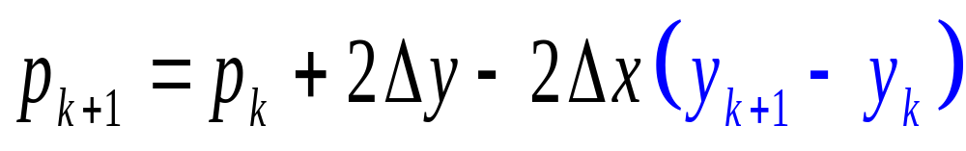
Recurrence Relation for p_{k}
+1
0 or +1

Slide 45
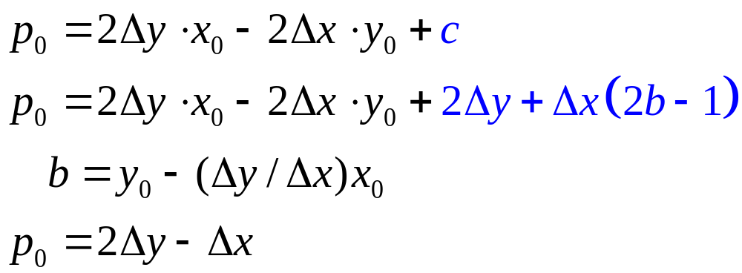
Initializing the Algorithm
Initial value of decision parameter

Slide 46
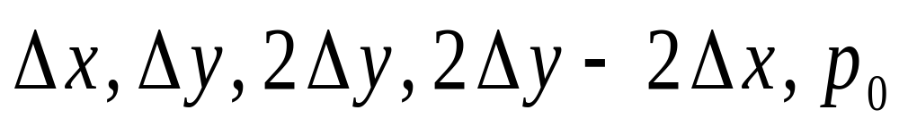
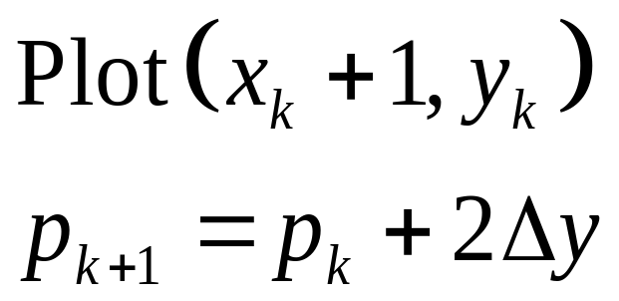
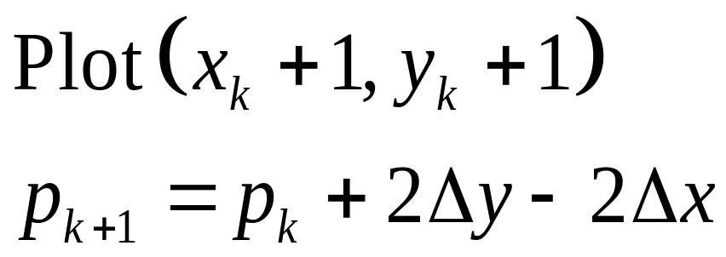
Bresenham Algorithm Summary
Calculate once:
At each point:
If p_{k} < 0:
If p_{k} >= 0:

Slide 47
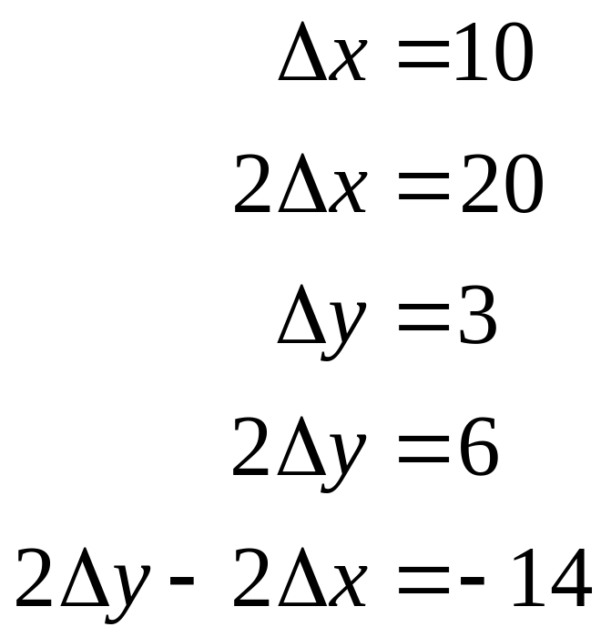
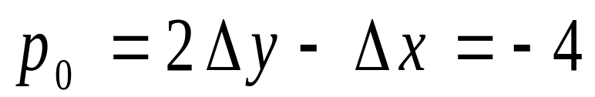
Example 1 Parameters
8
7
6
5
4
3
2
1
0
0
1
2
3
4
5
6
7
8
9
10
11

Slide 48
Example 1 Path
8
7
Same as simple line algorithm
6
5
4
3
2
1
0
0
1
2
3
4
5
6
7
8
9
10
11

Slide 49
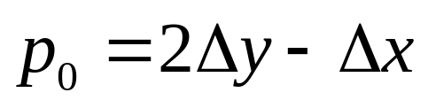
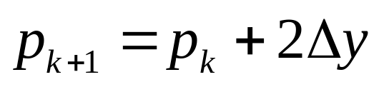
The Bresenham Line Algorithm
BRESENHAM’S LINE DRAWING ALGORITHM
(for |m| < 1.0)
Input the two line end-points, storing the left end-point in (x₀, y₀)
Plot the point (x₀, y₀)
Calculate the constants Δx, Δy, 2Δy, and (2Δy - 2Δx) and get the first value for the decision parameter as:
At each x_{k} along the line, starting at k = 0, perform the following test. If p_{k} < 0, the next point to plot is
(x_{k}+1, y_{k}) and:

Slide 50

The Bresenham Line Algorithm (cont…)
Otherwise, the next point to plot is (x_{k}+1, y_{k}+1) and:
Repeat step 4 (Δx – 1) times
NOTE! The algorithm and derivation above assumes slopes are less than 1. for other slopes we need to adjust the algorithm accordingly
Estimate the time taken to execute the task

Slide 51
Bresenham Modifications
So far, 0 < m < 1, Δx > 0
How do we handle other cases?
  Horizontal
  Vertical
  Other octants
    abs(Slope) ∈ (1, ∞]
      Transpose x with y, Δx with Δy, etc.
      Plot(y,x)
    Slope < 0
      Revise: y_{k+1} – y_{k} = 0 or -1
How to draw Parallel Lines?
Parallel Algorithms for GPU optimizations?

Slide 52
Bresenham Line Algorithm Summary
The Bresenham line algorithm has the following advantages:
  A fast incremental algorithm
  Uses only integer calculations
Comparing this to the DDA algorithm, DDA has the following problems:
  Accumulation of round-off errors can make the pixelated line drift away from what was intended
  The rounding operations and floating point arithmetic involved are time consuming

Slide 53
Drawing Circles and Arcs
Similar to line drawing
  In that you have to determine what pixels to activate
But non-linear
  Simple equation implementation
  Optimized

Slide 54

Cartesian form of
Circle Equations
(x_{c}, y_{c})
r
Not a very good method. Why?
Notes:
y(k) = y(c) + sqrt(r**2-(xk-xc)**2)

Slide 55





A Simple Circle Drawing Algorithm (cont…)

Slide 56
A Simple Circle Drawing Algorithm (cont…)
However, unsurprisingly this is not a brilliant solution!
Firstly, the resulting circle has large gaps where the slope approaches the vertical
Secondly, the calculations are not very efficient
  The square (multiply) operations
  The square root operation – try really hard to avoid these!
We need a more efficient, more accurate solution

Slide 57


Polar Coordinate Form
(x, y)
θ
r
Simple method: plot directly from parametric equations

Slide 58


Trig functions are expensive
Plots of first 1, 3, 5, 7, 9, 11, and 13 terms in the Taylor’s series for sin

Slide 59

Polygon Approximation
Calculate polygon vertices from polar equation; connect with line algorithm
(x_{i}, y_{i})

Slide 60
Mid-Point Circle Algorithm
Similarly to the case with lines, there is an incremental algorithm for drawing circles – the mid-point circle algorithm
In the mid-point circle algorithm we use eight-way symmetry so only ever calculate the points for the top right eighth of a circle, and then use symmetry to get the rest of the points
The mid-point circle algorithm was developed by Jack Bresenham, who we heard about earlier. Bresenham’s patent for the algorithm can be viewed here.

Slide 61


Midpoint Circle Drawing Algorithm
Consider this region

Slide 62



The Circle Decision Parameter
Calculate f_{circle} for point midway between candidate pixels
y_{k}
Now we can draw a circle, but this is unimpressive as it involves floating point arithmetic.
If p_{k} < 0:
If p_{k} >= 0:
x_{k}

Slide 63

Bresenham’s Integer Arithmetic: Calculating p_{k+1}

Slide 64



Recurrence Relation for p_{k}
Compute p_{k+1} - p_{k}

Slide 65



One Last Term …
If y_{k+1} = y_{k}, then:
If y_{k+1} = y_{k}-1, then:

Slide 66


Initial Values

Slide 67


Bresenham Midpoint Circle Algorithm Summary
At each point:
If p_{k} < 0:
If p_{k} >= 0:

Slide 68
Circle Example 1
r = 7
8
7
6
5
4
3
2
1
0
0
1
2
3
4
5
6
7
8
9
10
11

Slide 69
Symmetry Optimization
(-b, a)
(b, a)
(-a, b)
(a, b)
Calculate points for one octant; replicate in other seven
(-a, -b)
(a, -b)
(-b, -a)
(b, -a)

Slide 70



Bresenham’s Mid-Point Circle Algorithm
Bresenham’s MID-POINT CIRCLE ALGORITHM
Input radius r and circle centre (x_{c}, y_{c}), then set the coordinates for the first point on the circumference of a circle centred on the origin as:
Calculate the initial value of the decision parameter as:
Starting with k = 0 at each position x_{k}, perform the following test. If p_{k} < 0, the next point along the circle centred on (0, 0) is (x_{k}+1, y_{k}) and:

Slide 71



Bresenham’s Mid-Point Circle Algorithm (cont…)
Otherwise the next point along the circle is (x_{k}+1, y_{k}-1) and:
Determine symmetry points in the other seven octants
Move each calculated pixel position (x, y) onto the circular path centred at (x_{c}, y_{c}) to plot the coordinate values:
Repeat steps 3 to 5 until x >= y

Slide 72
Bresenham’s Mid-Point Circle Algorithm Summary
The key insights in the mid-point circle algorithm are:
  Eight-way symmetry can hugely reduce the work in drawing a circle
  Moving in unit steps along the x axis at each point along the circle’s edge we need to choose between two possible y coordinates

Slide 73
General Ellipse Equation
In general, ellipse described by constant sum of distances from foci
Difficult to solve equations and plot points
(use parametric polar form?)

Slide 74



Properties of Ellipses
Equation simplified if ellipse axis parallel to coordinate axis
Parametric form

Slide 75




Symmetry Considerations
4-way symmetry
Unit steps in x until reach region boundary
Switch to unit steps in y
Step in x while
Switch to steps in y when

Slide 76



Midpoint Algorithm (initializing)
Similar to circles
The initial value for region 1
The initial value for region 2
We have initial values, now we need the increments
1994 Foley/VanDam/Finer/Huges/Phillips ICG

Slide 77




Making a Decision
Computing the decision variable
If then M is below the arc,
hence the E pixel is closer to the line.
If then M is above the arc,
hence the SE pixel is closer to the line.

Slide 78


Computing the Increment
E case
SE case
1994 Foley/VanDam/Finer/Huges/Phillips ICG

Slide 79









Computing the Increment
Computing the increment incrementally…
and can be pre-computed
Only and need to be recomputed for each point
At the initial position (0,r_{y}), and
The new values of the increment can be computed by adding to (1 & 2) and subtracting from (2)

Slide 80


Computing the Increment in 2nd Region
Decision variable in 2nd region
If then M is left of the arc,
hence the SE pixel is closer to the line.
If then M is right of the arc,
hence the S pixel is closer to the line.
1994 Foley/VanDam/Finer/Huges/Phillips ICG

Slide 81

Computing the Increment in 2nd Region
SE case
S case

Slide 82

Midpoint Ellipse Algorithm

Slide 83

Midpoint Ellipse Algorithm (cont.)

